Slide 1
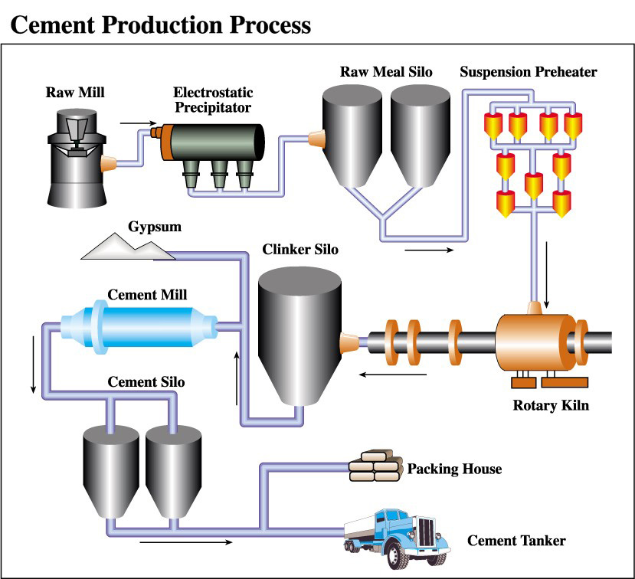

Cement Manufacturing Automation
Presented by:K.N.Raghavendra
Under the guidelines of; Ankita Yadav

Slide 2

Project Leadership
Bharani Kumar Depuru
Director & Co-Founder at Innodatatics | Chief Data Scientist
https://www.linkedin.com/in/bharanikumardepuru?utm_source=share&utm_campaign=share_via&utm_content=profile&utm_medium=android_app

Slide 3

Contents
Business objective
Business Constraints
Project Architecture
Data collection and details
Exploratory Data Analysis
Visualization
Notes:
Change

Slide 4
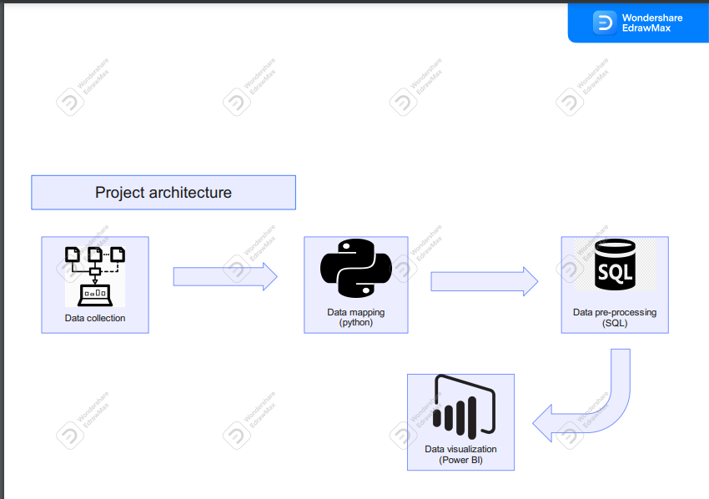
Project Overview and Scope

Slide 5

Business Problem
Sample of cement manufactured is taken at a regular interval of 1 hour or so and tested in labfor quality check

Slide 6

Business Objective
Constraints
Objective
Minimize manual intervention
Cement Manufacture Proces
Cement Residue
Minimize the time between intervals of quality check

Slide 7




Technical Stacks

Slide 8


Data Collection and Understanding
The data was provided by client.
The dataset consists of columns pertaining to dates, diverse measurements of Total Petroleum Hydrocarbons (TPH), industrial fan performance metrics, and intermediary results such as Reject and Mill Folaphone readings.
Reject, Residue (45µ) is the output columes.
As per our client's specifications, if the Residue (45µ) falls within the range of 12 to 14 percent, it can be deemed as high-quality cement.

Slide 9
Data Dictionary & Data Information
Mill TPH: Mill Throughput in Tons per Hour
Clinker TPH: Clinker Throughput in Tons per Hour
Gypsum TPH: Gypsum Throughput in Tons per Hour
DFA TPH: Direct Fired Air Throughput in Tons per Hour
WFA TPH: Wet Fired Air Throughput in Tons per Hour
Mill KW: Mill Power in Kilowatts
Mill I/L Temp: Mill Inlet Temperature
Mill O/L Temp: Mill Outlet Temperature
Mill O/L BE Amp: Mill Outlet Bearing Amps
Mill Vent Fan RPM: Mill Ventilation Fan Revolutions per Minute
Mill Vent Fan KW: Mill Ventilation Fan Power in Kilowatts
Mill Vent BF I/L Draft: Mill Ventilation Bag Filter Inlet Draft
Mill Vent BF O/L Draft: Mill Ventilation Bag Filter Outlet Draft
Reject: Rejected Material Percentage
Sep RPM: Separator Revolutions per Minute
Sep KW: Separator Power in Kilowatts
Sep Amp: Separator Amperage
CA Fan RPM: Combustion Air Fan Revolutions per Minute
Mill Falophone: Mill Sound Measurement (Falophone)
Mill I/L Draft: Mill Inlet Draft
Mill O/L Draft: Mill Outlet Draft
Sep. Vent I/L Draft: Separator Ventilation Inlet Draft
Sep. Vent O/L Draft: Separator Ventilation Outlet Draft
Sep. Vent bag filter fan KW: Separator Ventilation Bag Filter Fan Power in Kilowatts
CA Fan KW: Combustion Air Fan Power in Kilowatts
Sep. Vent bag filter fan RPM: Separator Ventilation Bag Filter Fan Revolutions per Minute
Residue (45µ): Residue at 45 Microns
In tha data set we have
Columns = 28
Rows = 5505

Slide 10

System Requirements
Hardware: Modern computer with multi-core processor, sufficient RAM, and ample storage space.
Operating System: Windows, macOS, or Linux based on tool preference.
Software: Data analysis tools (e.g., Python, R), DBMS (e.g., MySQL), visualization tools, IDEs, and necessary software.
Internet Connection: Stable internet access for data retrieval and updates.
Security and Privacy: Implement data security and privacy measures.
Backup and Data Storage: Establish backup systems and consider cloud storage.
Memory and Processing Power: Adequate resources for complex projects.
Collaboration Tools: Version control and project management software.
Training and Support: Ensure team training and access to support.
Scalability: Plan for potential project growth.

Slide 11

Exploratory Data Analysis [EDA]
The initial unprocessed data underwent exploration and analysis (EDA).
There were 4 instances of missing values within the dataset.
The data set contained 10 rows that were identical duplicates.
Outlying data points were identified in every single column.
As per the client's instructions, if the percentage of outliers was below 10%, outlier treatment was to be carried out.
Outlier treatment was executed on all columns, excluding Mill Vent BF I/L Draft, and Mill Folaphone.
Within the dataset, several columns such are non-normal distributions.
Notes:
EDA is used for seeing what the data can tell us before the modeling task.
Change

Slide 12

Missing Values Observation
A total of 4 missing values were identified.
These 4 missing values were associated with the columns DFA TPH, Mill Vent BF OIL Draft, Sep KW, and Sep Vent Bag Filter Fan RPM.
Given the limited number of 4 missing values, they were addressed using the mean imputation method in SQL.

Slide 13
Data Preprocessing
Following the exploratory data analysis (EDA) of the raw, unprocessed data, data pre-processing steps were carried out. The process involved the usage of SQL (potentially a type for SQL).
Data Pre-Processing encompassed the following actions:
Ensuring uniformity in data types for all attributes.
Removing duplicate rows from the dataset.
Addressing missing values through median imputation.
Detecting outliers within the data.
Calculating the 1st and 3rd quartile ranges (IQR) for each attribute.
Identifying columns with outlier percentages less than 10%.
Applying the winsorization method to handle outliers in such attributes.
Examining the data distribution for each attribute.
Normalizing the data distribution using techniques like log transformation and box-cox transformation.
Notes:
Keep observations

Slide 14
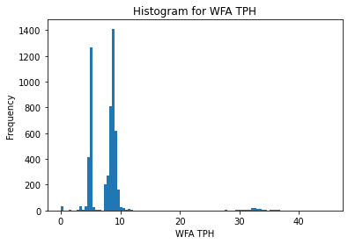
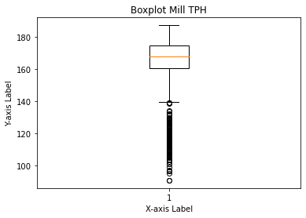
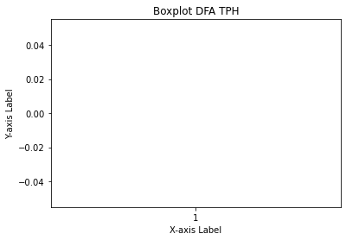
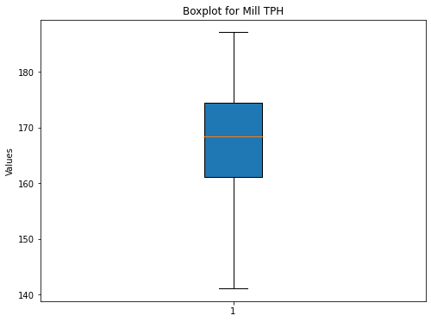
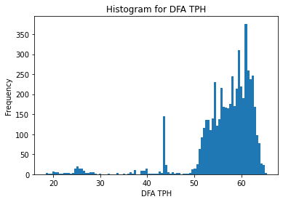
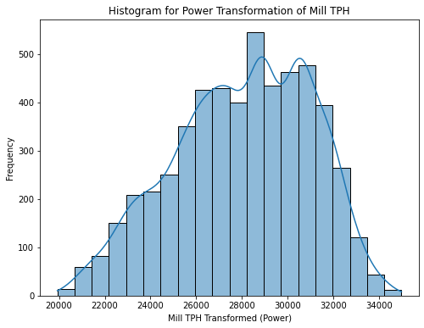
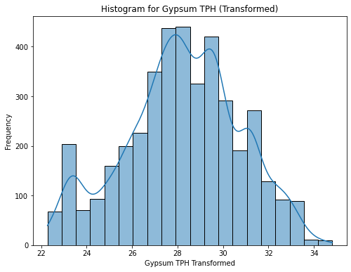
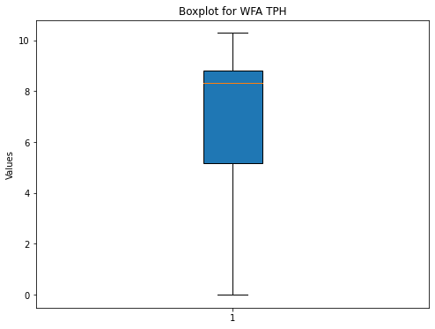
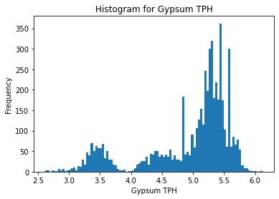
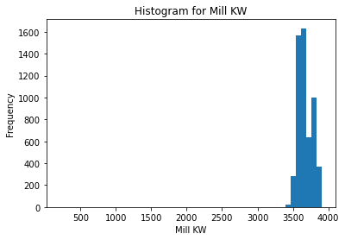
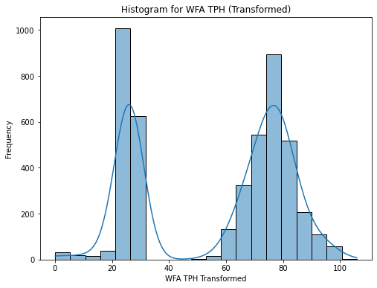
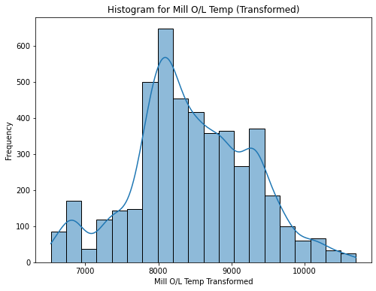
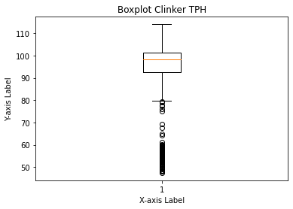
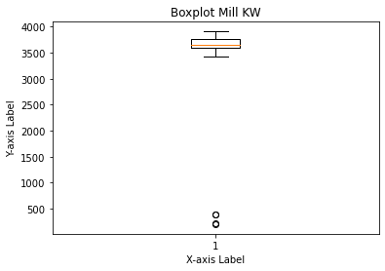
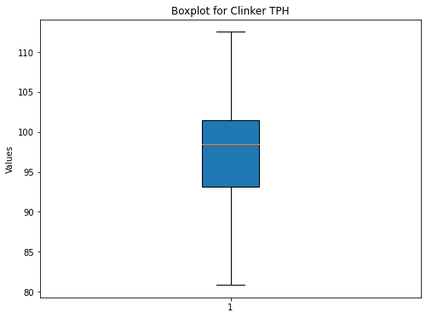
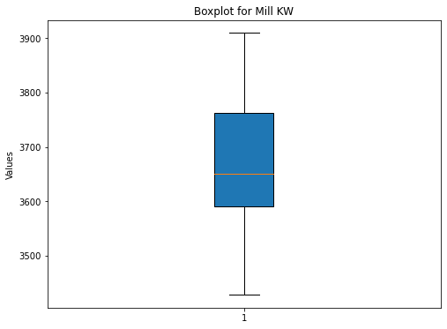
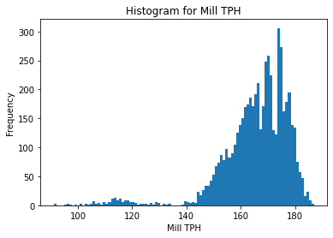
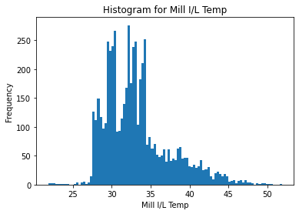
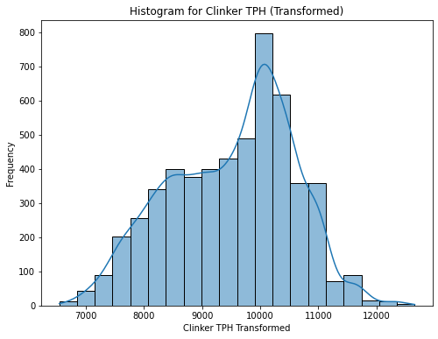
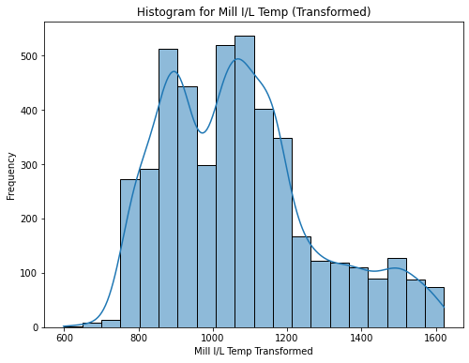
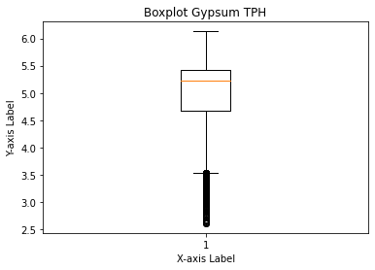
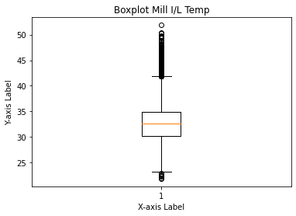
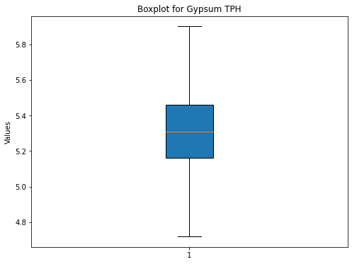
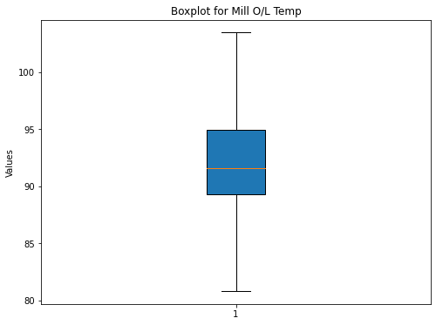
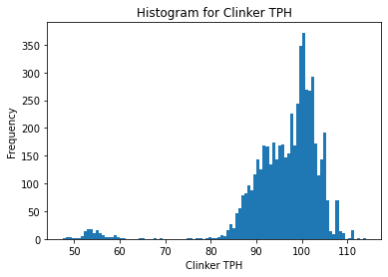
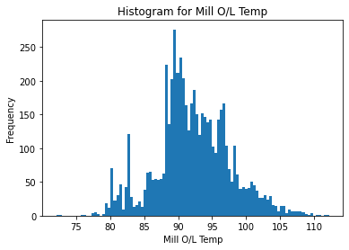
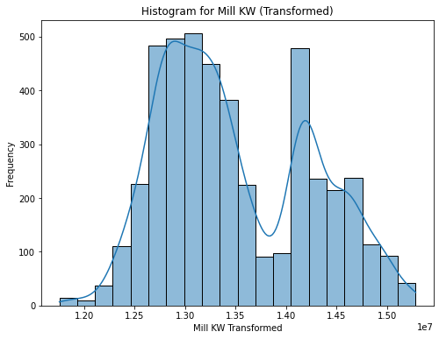
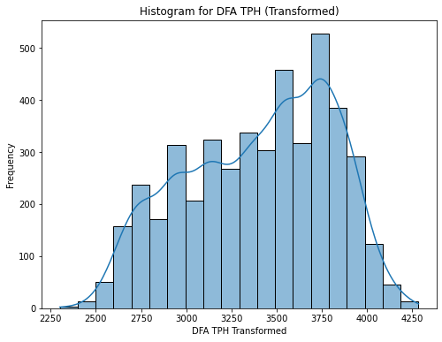
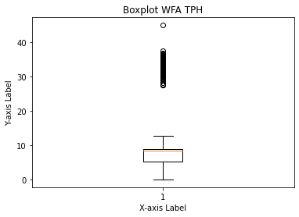
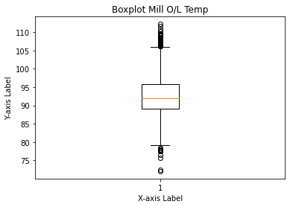

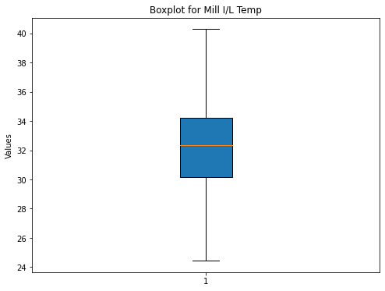
Data Preprocessing
Before preprocessing
After preprocessing
Before preprocessing
After preprocessing

Slide 15

Data Visualization
Power Bi was utilized for data visualization.
Data from MySQL was exported to Power B using the MySQL connector.
Pre-processing of data took place using Power Query.
A separate date table was created to facilitate time-based analysis.
A one-to-many active relationship was established between the current table and date table.
DAX measures and DAX calculated columns were created to derive meaningful insights.
Bookmarks were used for page navigation within the reports.
Two report-level slicers were added to filter data by year, month, and cement quality.
Text parameters and dynamic slicers were employed to analyze monthly industrial inputs.
Notes:
Add graphical

Slide 16
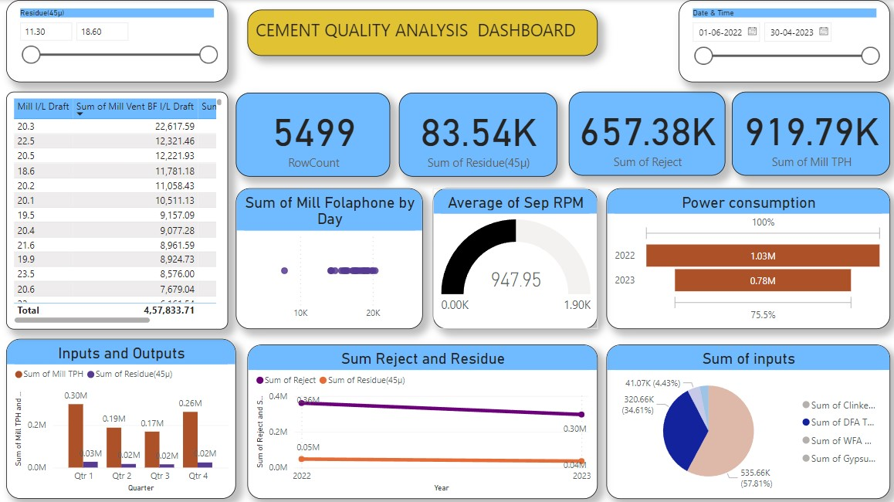
Published Dashboard

Slide 17

Challenges
Addressing outliers in SOL by calculating Q1, Q3, and GH values, then replacing outliers with appropriate formulas.
Normalizing data distribution, particularly in SQL, using Box Cox and Log transformations.
Overcoming errors in implementing auto-EDA tools like auto-vie and pandas profiling through library updates and configurations.
Mastering the use of bookmarks to manage slicers and toggle between different views, which initially posed challenges but were successfully overcome through careful execution.

Slide 18

Future Scopes
Predictive Maintenance: Use AI to forecast equipment failures and reduce downtime based on Mill KW and Sep KW metrics.
Optimization Models: Employ advanced algorithms to maximize production output (Mill TPH, Clinker TPH) and minimize resource consumption (Gypsum TPH, DFA TPH, power usage).
Quality Control: Develop machine learning models for precise predictions of product quality using operational data.
Real-time Monitoring: Implement real-time dashboards for instant feedback on critical metrics to operators and managers.
Supply Chain Integration: Optimize logistics and inventory management by aligning production with raw material needs.
Sustainability Integration: Enhance resource efficiency and reduce environmental impact in supply chain management while focusing on sustainability.

Slide 19

Queries ?

Slide 20


